Slide 1

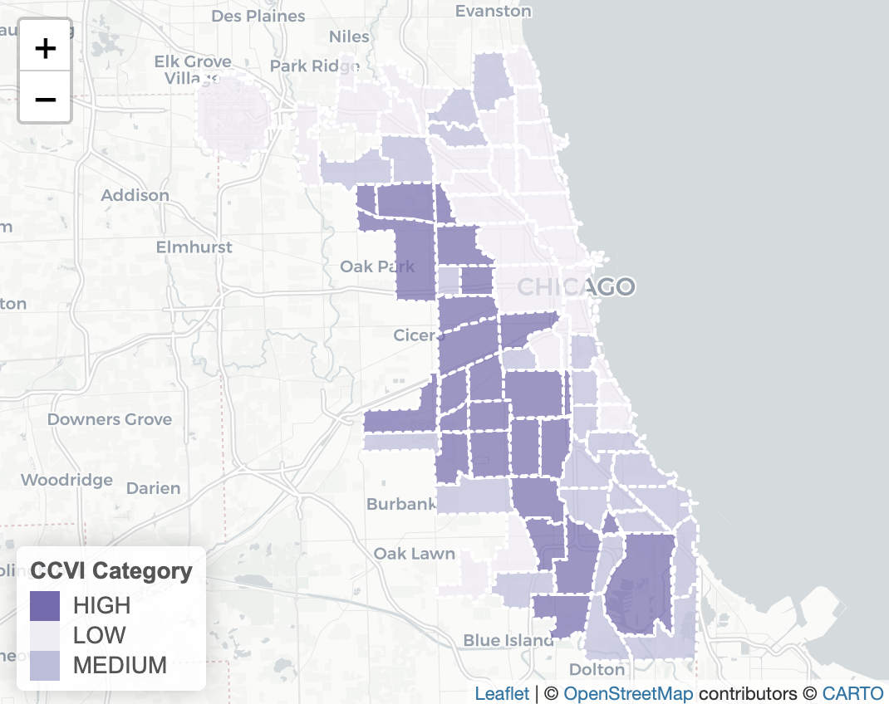
In the space below to copy/paste/insert a custom version (new color palette) of Figure 1 (map of CCVI Scores by Community Area) from the exercise.
GEO 3330 Sustainable Urban Transportation
Exercise #2: L Station Ridership Trends
Describe here any patterns you see in the map. Use data from the map to describe characteristics of at least one community located within each of the three CCVI categories.
The south and west sides of Chicago seem to have been disproportionately impacted/burdened by COVID.
High – Belmont Cragin (52.4) The crude mortality rate here is 62/77
Medium – Woodlawn (37.8) Socioeconomic status is 54/77
Low – Loop (8.3) Hospitalization rate is 0/77

Slide 2
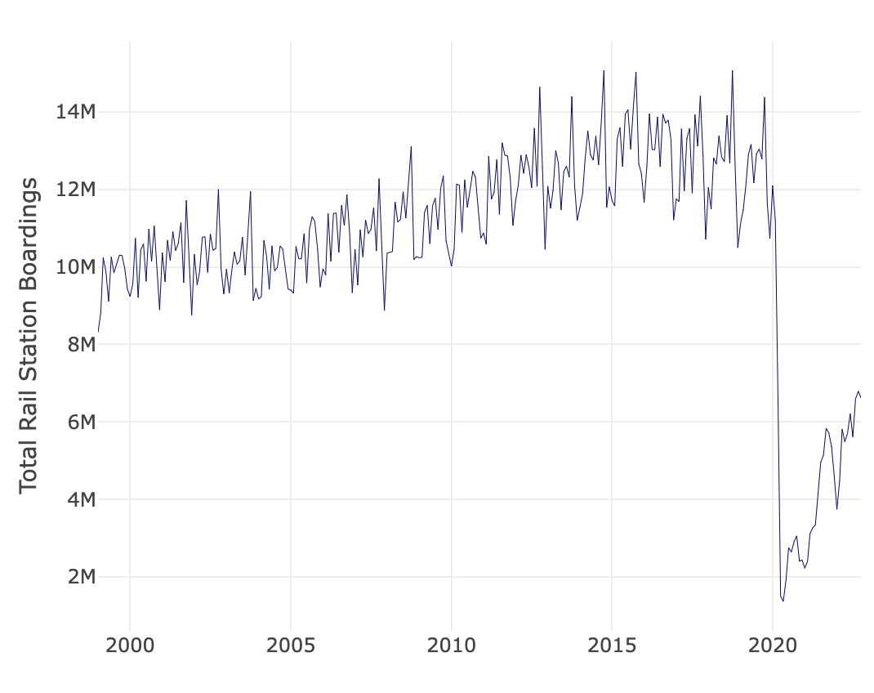
In the space below to copy/paste/insert Figure 2 or 3 from the exercise.
GEO 3330 Sustainable Urban Transportation
Exercise #2: L Station Ridership Trends
Describe patterns in rail boardings between 1999 and 2022. What do you think explains some of the cyclical variations in the data? What other factors may explain ridership over this period? Draw from the daily ridership plot to characterize ridership trends during the pandemic.
Rail boardings between 1999 and 2015 were gradually increasing with what appears to be decreased ridership during the winter months. October was consistently the month with the highest amount of boardings. I equate this to the population being more open to waiting on outdoor platforms during the warmer months. From 2015 to 2020 ridership started decreasing slowly until the COVID pandemic diminished boardings so drastically that only 1.3 million people boarded the rail system throughout the month of May 2020. Since then it has increased to about 45% pre-pandemic levels.

Slide 3
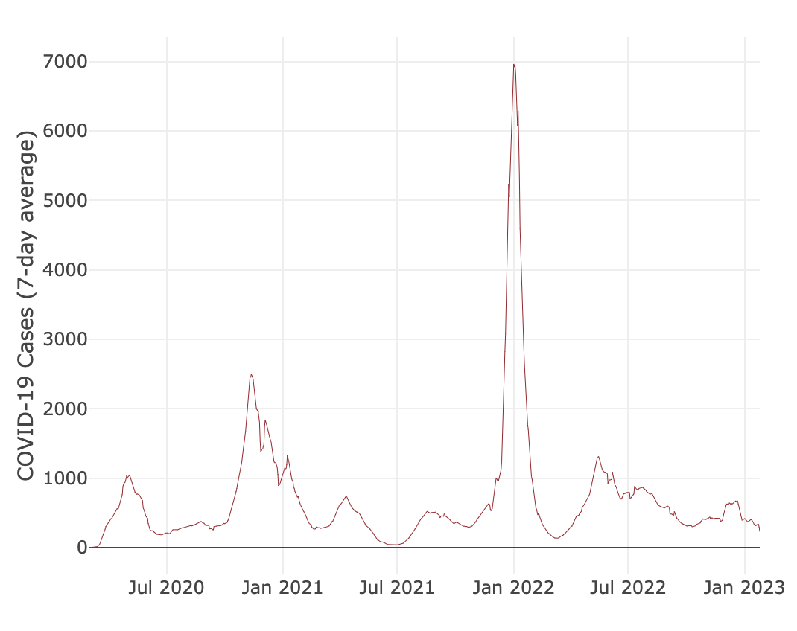
In the space below to copy/paste/insert Figure 4 from the exercise.
GEO 3330 Sustainable Urban Transportation
Exercise #2: L Station Ridership Trends
Are the waves and phases of the pandemic evident? Compare these pandemic phases to ridership trends over the same period. Do they appear to be related?
The waves and phases are very evident—especially during the omicron surge in early 2022. As one would expect, this is inversely related to the ridership shown previously; however it seems that the omicron’s 7000 cases per week on average did not have nearly the effect that the early 2020 gain in cases (which drastically diminished the CTAs boardings in May 2020) did.

Slide 4
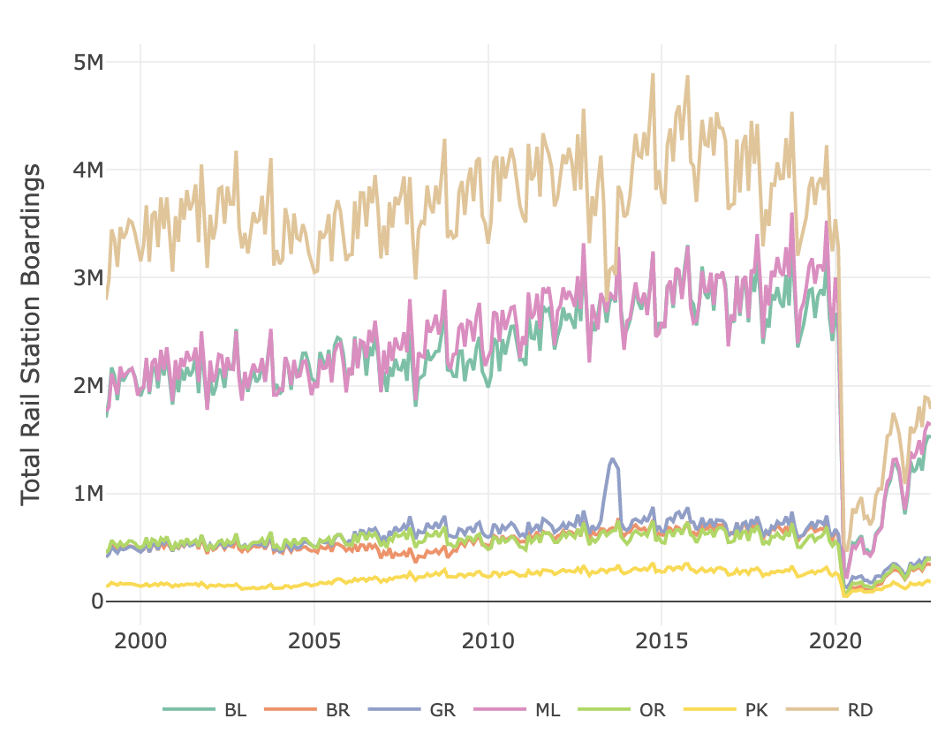
In the space below to copy/paste/insert Figure 5 or 6 from the exercise.
GEO 3330 Sustainable Urban Transportation
Exercise #2: L Station Ridership Trends
How does ridership vary with respect to station CCVI and line?
All lines’ ridership decreased at the beginning of the pandemic however some are recovering at a quicker rate than others. The Purple, Red, and Blue line are recovering the quickest despite a dip during the omicron variants wave in early 2022. The Red and Blue lines are 24 hours and serve major population centers therefore their recovery makes sense. The Purple line is most likely recovering at a similar rate because of its express service to Evanston. The rest of the lines are slowly recovering, however, the pink line seems to be staying somewhat stagnant and not adding new riders. I’m not too sure why this is, as the Pink line serves a large portion of the south west community. That area was in the region most affected by COVID so perhaps that population is wary of returning to the public transit which has an inherently contagious element.

Slide 5
Summarize some potential short- and longer-term implications the pandemic has had on sustainable transportation and public transit ridership?
I think that short-term implications from the pandemic on transit mean that more people will opt to take private forms of transportation and will be wary of returning to services like the CTA. It is possible that in the future, ridership will return but I think that with more people working from home, there is less of a need for people to take the trains and buses throughout the city for something essential like a job. The majority of trips for white collar workers may simply be for pleasure/entertainment. For those people who depend on the CTA, this trend (after the initial decent of ridership in May 2020) is a good sign that the service will continue and is not rendered obsolete.
To summarize: during the pandemic, sustainability was not necessarily helped or hurt because the increased use of a private vehicle (inherently unsustainable) is offset by the amount of people not going anywhere and thus having a lower carbon-footprint. In the long-run, I think that the push towards environmentalism will make more people want to use a bus or metro to get from place to place.
GEO 3330 Sustainable Urban Transportation
Exercise #2: L Station Ridership Trends
What strategies do you propose to help return transit to pre-pandemic levels?
I would focus on street design. If driving were not the most convenient way to get people from point A to point B in Chicago and the CTA were, then people would take the train. Street design, such as speed humps in neighborhoods, ‘traffic-peanuts’ at the large 6-way intersections (link here) and more provisions for bikers and pedestrians can make a large difference in getting cars off the road and people into more sustainable forms of transportation.
The other thing, and probably a bit more doable, would be to increase headways. The newly proposed bus schedule which doesn’t account for peak times doesn’t seem to be helping transit ridership return and is forcing people to use ride-sharing or use other modes than the CTA. If the CTA were more reliable, I think that ridership would return to pre-pandemic levels.
Lastly, I read a while ago about the return to A/B service on trains such as the Blue line and how that could create more accountability and reliability in the transit system. My knowledge is only surface-level, but I thought it was interesting in the context of returning ridership to what it was and maybe even beyond.

